Slide 1

Learning Objective
I will factorise monic quadratic expressions.
Enter quietly, please be ready with the following on your desk:
Whiteboard
Whiteboard marker
Exercise Book
Pencil, pen, ruler and red pen
Diary
Calculator
Device – charged or borrowed from Library before maths

Slide 2



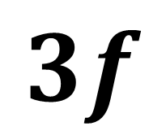
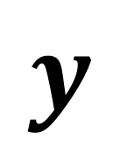

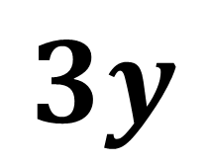

Daily Review
Expand the following expression:
$$3y (y+3f)$$
$$3y lots of (y+3f)$$
$$y$$
$$3f$$
$$3y (y+3f)$$
$$3y$$
$$3y2$$
$$9fy$$
$$=3y2+9fy$$

Slide 3


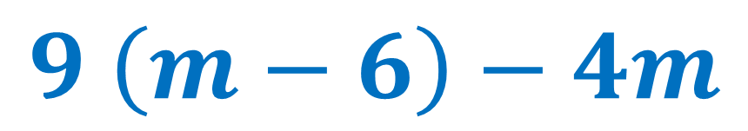
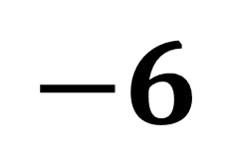


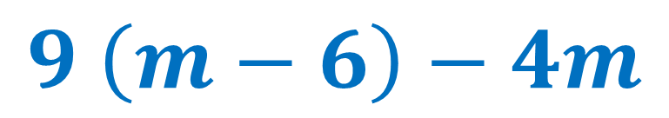
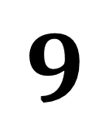
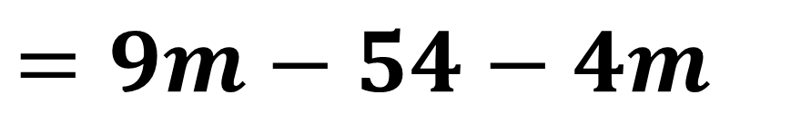
Daily Review
Expand the following expression:
$$9 \left(m−6\right)−4m$$
$$9 lots of \left(m−6\right), then take away 4m$$
$$m$$
$$−6$$
$$9 \left(m−6\right)−4m$$
$$=9m−54−4m$$
$$9$$
$$9m$$
$$−54$$
$$=5m−54$$

Slide 4





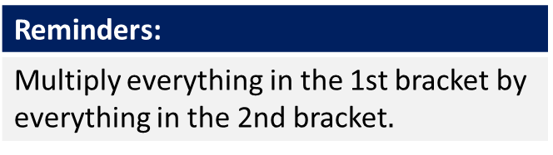






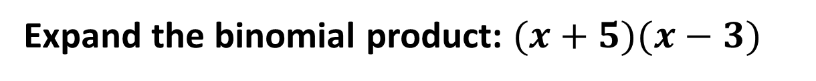
Daily Review
Reminders:
Multiply everything in the 1st bracket by everything in the 2nd bracket$.$
Expand the binomial product: $(x+5)(x−3)$
$$x$$
$$−3$$
$$(x+5)(x−3)$$
$$x$$
$$x^{2}$$
$$−3x$$
$$=x^{2}+5x−3x−15$$
$$5$$
$$5x$$
$$−15$$
$$=x^{2}+2x−15$$

Slide 5











Daily Review
Reminders:
Multiply everything in the 1st bracket by everything in the 2nd bracket$.$
Expand the binomial product: $(3x−1)(2x−5)$
$$2x$$
$$−5$$
$$(3x−1)(2x−5)$$
$$3x$$
$${6x}^{2}$$
$$−15x$$
$$={6x}^{2}−15x−2x+5$$
$$−1$$
$$−2x$$
$$5$$
$$={6x}^{2}−17x+5$$

Slide 6


Daily Review
What’s the highest common factor of:
3 and 15 ?
9 and 15?
4 and 14?
6 and 20?
12 and 20?
3
3
2
2
4
$x and 3x$?
$3a and 5a$?
$5xy and 10x$?
$6c and 15c^{2}$ ?
$11a^{2}b and −33ab^{2}$ ?
$$x$$
$$a$$
$$5 x$$
$$3 c$$
$$11 a b$$

Slide 7
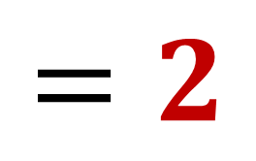


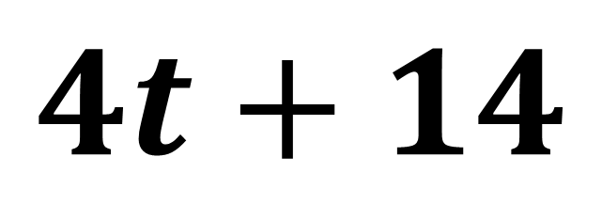
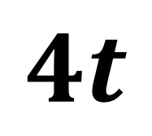


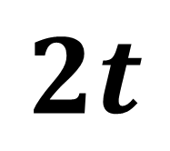
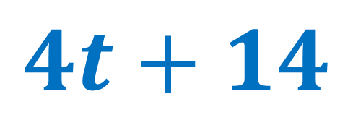
Daily Review
CFU 1
How do we expand an expression?
Find the HCF of the two terms.
Divide the term by the HCF.
CFU 2
How do we factorise an expression?
$$4t+14$$
Vocabulary
Expanding Factorising
$$2t$$
$$7$$
$$4t+14$$
$$2$$
$$4t$$
$$14$$
$$=2$$
$$(2t+7)$$

Slide 8

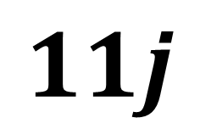


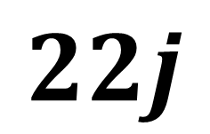
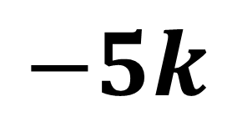



Daily Review
CFU 1
How do we expand an expression?
Find the HCF of the two terms.
Divide the term by the HCF.
$$22j−55jk$$
CFU 2
How do we factorise an expression?
Vocabulary
Expanding Factorising
$$2$$
$$−5k$$
$$22j−55jk$$
$$11j$$
$$22j$$
$$−55jk$$
$$=11j$$
$$(2−5k)$$

Slide 9
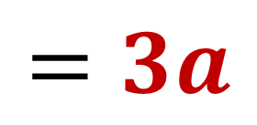
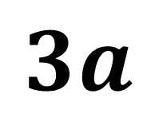
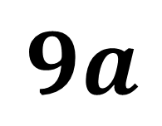
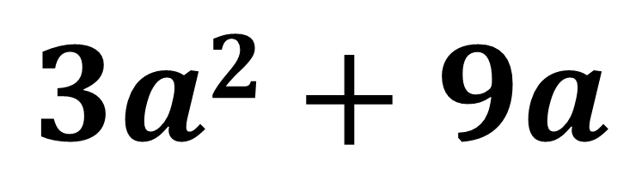


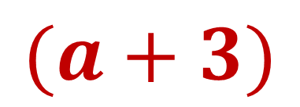


Daily Review
CFU 1
How do we expand an expression?
Find the HCF of the two terms.
Divide the term by the HCF.
CFU 2
How do we factorise an expression?
$$3a2+9a$$
Vocabulary
Expanding Factorising
$$a$$
$$3$$
$$3a2+9a$$
$$3a$$
$$3a2$$
$$9a$$
$$=3a$$
$$(a+3)$$

Slide 10
Learning Objective
CFU 1
What will we learn?
I will factorise monic quadratic expressions.
CFU 2
What will we learn?
CFU 3
How will we know if we’ve been successful?
Success Criteria
CFU 4
How will we know if we’ve been successful?
I will be able to:
Find factors of a number.
Factorise monic quadratic expressions.

Slide 11













Activate Prior Knowledge
Reminders:
Multiply everything in the 1st bracket by everything in the 2nd bracket$.$
Expand the brackets:
$$(t+3)(t+7)$$
What do we do with $7t$ and $3t$?
$$t$$
$$7$$
Add them.
$$t$$
$$t^{2}$$
$$7t$$
What do we do with $7$ and $3$?
$$3$$
$$3t$$
$$21$$
Multiply them.
$$=t^{2}+7t+3t+21$$
$$=t^{2}+10t+21$$

Slide 12







Concept Development
Expanding is the process where you remove the brackets.
Factorising is the reverse - you are putting the brackets in.
$$t^{2}+10t+21$$
$$t$$
We are looking for two numbers that multiply together to make 21.
1 and 21
3 and 7
$$t$$
$$t^{2}$$
$$?t$$
We are also looking for two numbers that add together to make 10.
3 and 7
$$?t$$
$$21$$

Slide 13




Concept Development
Expanding is the process where you remove the brackets.
Factorising is the reverse - you are putting the brackets in.
$$t^{2}+10t+21$$
$$t$$
$$3$$
We are looking for two numbers that multiply together to make 21.
1 and 21
3 and 7
$$t$$
$$t^{2}$$
$$3t$$
We are looking for two numbers that also add together to make 10.
3 and 7
$$7$$
$$7t$$
$$21$$
$$t^{2}+10t+21=(t+3)(t+7)$$

Slide 14

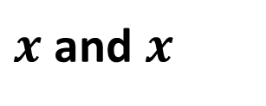







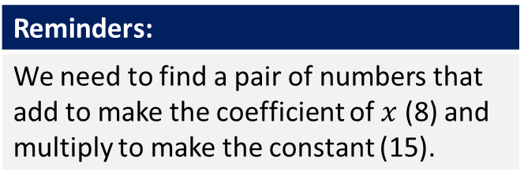
Skill Development/Guided Practice
Reminders:
We need to find a pair of numbers that add to make the coefficient of $x$ (8) and multiply to make the constant (15).
$$x^{2}+8x+15$$
$x$ and $x$
What do you multiply together to make $x^{2 }$?
$$x$$
$$3$$
1 and 15
3 and 5
What do you multiply together to make 15?
$$x$$
$$x^{2}$$
$$3x$$
$$5$$
$$5x$$
$$15$$
What do you also add together to make 8?
3 and 5
$$x^{2}+8x+15=(x+3)(x+5)$$

Slide 15






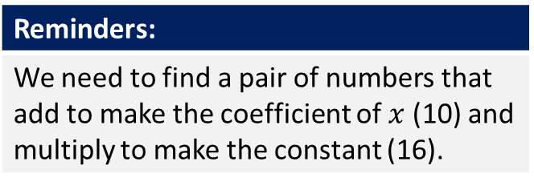
Skill Development/Guided Practice
Reminders:
We need to find a pair of numbers that add to make the coefficient of $x$ (10) and multiply to make the constant (16).
$$x^{2}+10x+16$$
$x$ and $x$
What do you multiply together to make $x^{2 }$?
$$x$$
$$2$$
1 and 16
2 and 8
4 and 4
What do you multiply together to make 16?
$$x$$
$$x^{2}$$
$$2x$$
$$8$$
$$8x$$
$$16$$
What do you also add together to make 10?
2 and 8
$$x^{2}+10x+16=(x+8)(x+2)$$

Slide 16





Skill Development/Guided Practice
Reminders:
We need to find a pair of numbers that add to make the coefficient of $x$ (10) and multiply to make the constant (25).
$$x^{2}+10x+25$$
$x$ and $x$
What do you multiply together to make $x^{2 }$?
$$x$$
$$5$$
1 and 25
5 and 5
What do you multiply together to make 25?
$$x$$
$$x^{2}$$
$$5x$$
$$5$$
$$5x$$
$$25$$
What do you also add together to make 10?
5 and 5
$$x^{2}+10x+25=(x+5)(x+5)$$

Slide 17



Skill Development/Guided Practice
Reminders:
We need to find a pair of numbers that add to make the coefficient of $x$ (11) and multiply to make the constant (24).
$$x^{2}+11x+24$$
$x$ and $x$
What do you multiply together to make $x^{2 }$?
$$x$$
$$3$$
1 and 24
2 and 12
3 and 8
4 and 6
What do you multiply together to make 24?
$$x$$
$$x^{2}$$
$$3x$$
$$8$$
$$8x$$
$$24$$
What do you also add together to make 11?
3 and 8
$$x^{2}+11x+24=(x+8)(x+3)$$

Slide 18
Independent Practice
No Pearson
Mathspace task – Year 10 Mainstream Factorising Monic Quadratics CLASSWORK

